Slide 1

Nick(s) and Friends
Microsoft Malware Prediction

Slide 2
Why this matters to Microsoft

Slide 3
The Problem: Malware is a growing threat to Microsoft’s mission of empowering people and organizations
Both the frequency and cost associated with malware attacks are increasing rapidly
Avg. Cost of
Malware Attack
Increase in Ransomware Attacks
Global Cost of Ransomware Attacks
$2.4 M
57x
$20 B
between 2015 - 2021
Source: Accenture Cost of Cybercrime Study 2020
Source: Cybersecurity Ventures
Source: Cybersecurity Ventures

Slide 4
Our Goal
Better predict malware risk through machine learning to lower malware infection rate for Microsoft customers

Slide 5
Our process
Use insights to build model
Obtain importance of data from model
Re-visualize “important” data
Build insights into model and make recommendations
Visualize data
(Start here)

Slide 6
Initial visualizations

Slide 7
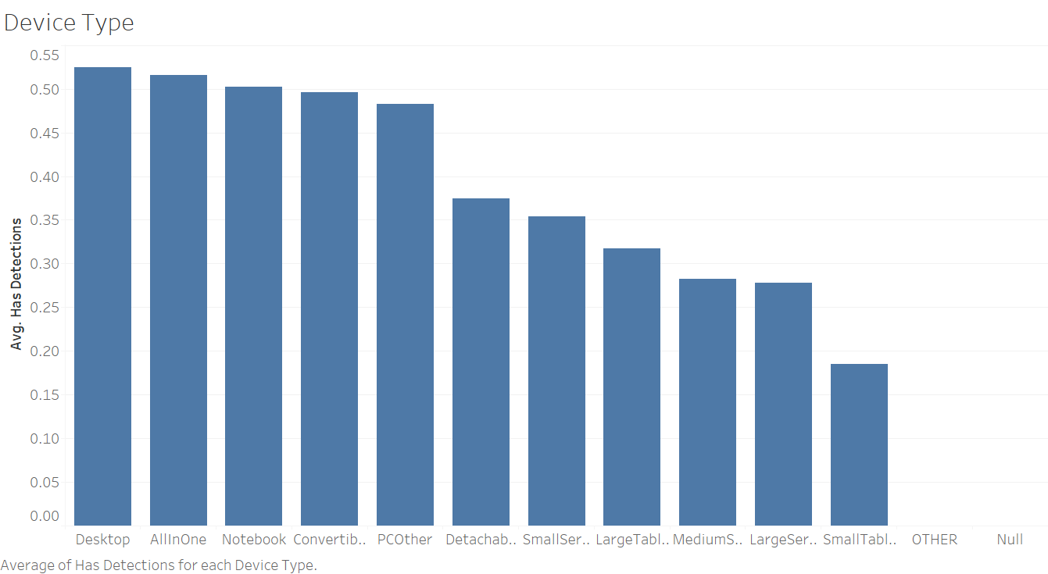
Device Type Reasoning: our general computer knowledge leads us to believe device type could be important Insight: servers/cloud and tablets have fewer detections

Slide 8
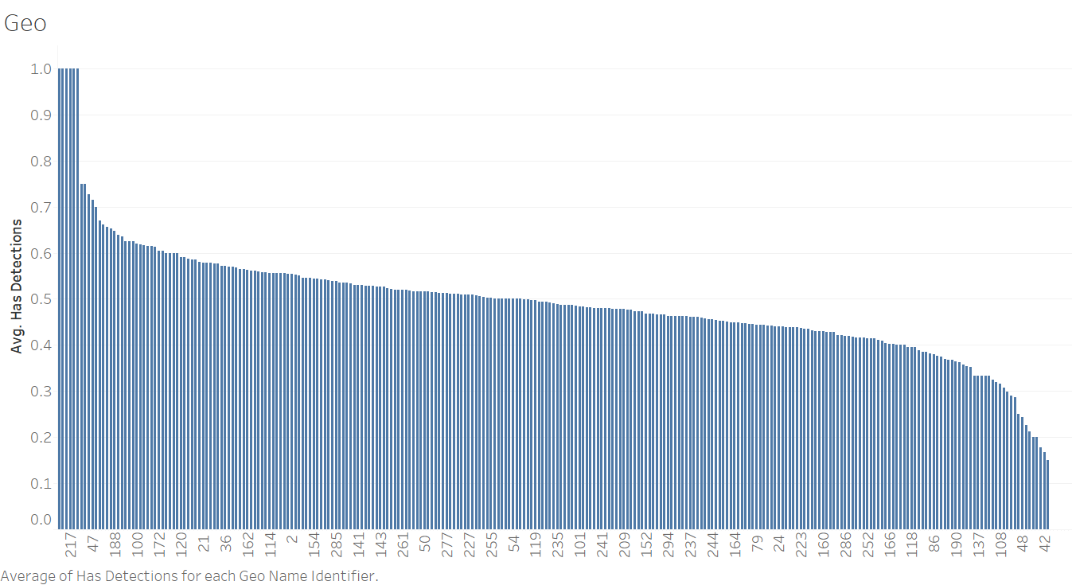
Geography Reasoning: certain locations might be more susceptible to malware (e.g., different regulations, access to updated tech) Insight: it’s difficult to tell where detections are more likely because we cannot get details on numbers, but geography plays a role
Data

Slide 9
Key insights and visualizations

Slide 10



Data Categories
Data set contains 82 columns, which can conceptually be grouped into three broad categories:
Hardware
Software
Settings
Examples:
Processor
Census_MDC2FormFactor
Census_OEMNameIdentifier
Census_ProcessorCoreCount
Census_PrimaryDiskTotalCapacity
Examples:
AppVersion
IsBeta
OsVer
OsPlatformSubRelease
SkuEdition
Examples:
SmartScreen
Firewall
AVProductStatesIdentifier
SMode
UacLuaenable

Slide 11
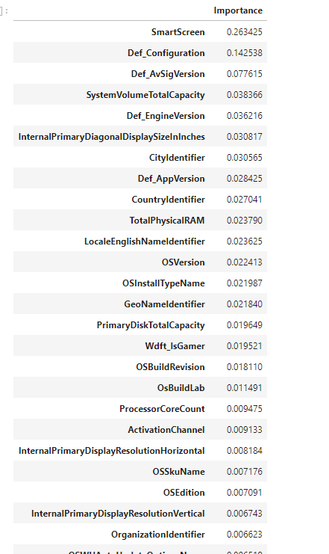
After building our model, we noticed a key theme among the importance of variables: configurations, settings, and versions.
Why is this important? 95% of people don’t change their settings, so if their computer isn’t safe to begin with, they are susceptible to malware.

Slide 12
Industry Research
Overall, default configurations can sometimes leave systems less secure than if they were to be covered by additional systems.
Default Settings
SmartScreen
User Initiative
Even if you have other security software installed, SmartScreen can protect you from something your main security program might miss
95% of users do not change anything when it comes to settings, even more specifically downloading protection
Default configurations can sometimes leave systems less secure than recommended
Source: ScienceDirect
Source: HowToGeek
Source: The Guardian

Slide 13
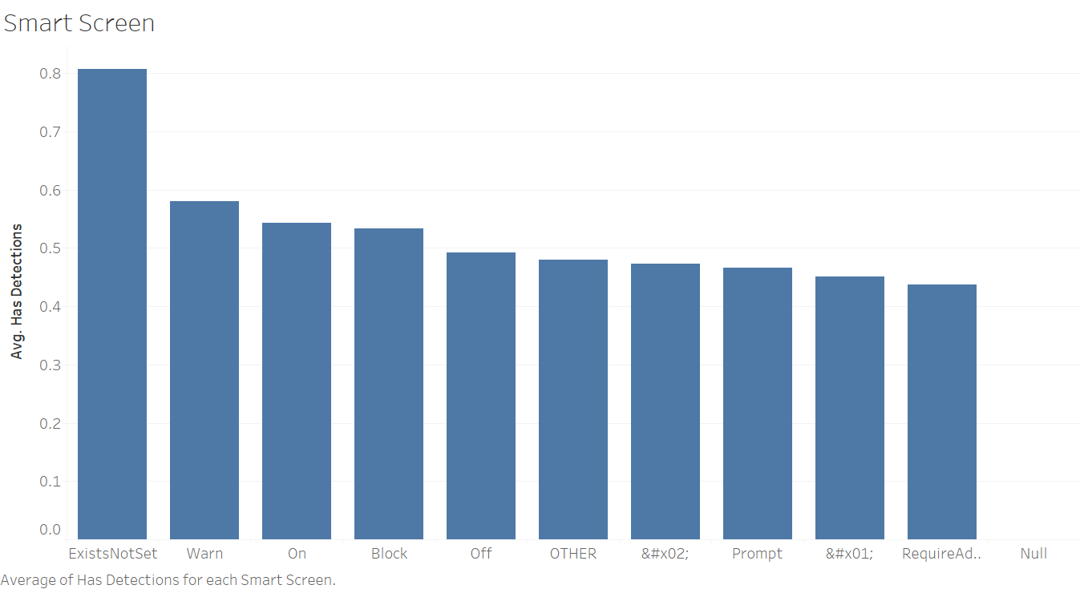
SmartScreen Enabling any feature of SmartScreen (such as Warn, On, etc.) reduces detections

Slide 14
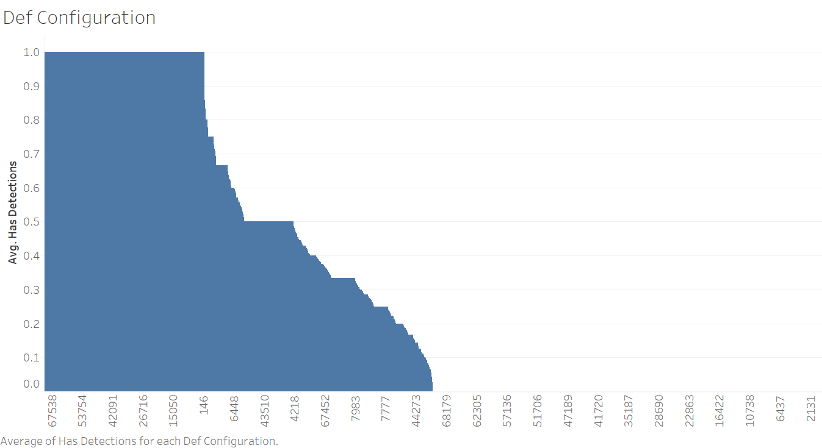
Defender Configuration Certain configurations leave computers more susceptible to detections

Slide 15
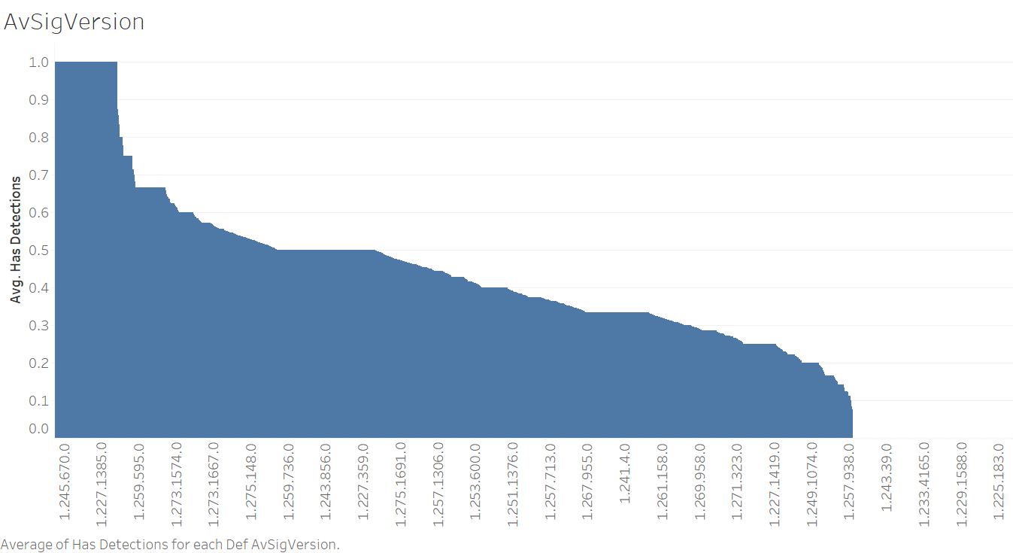
AvSigVersion (Antivirus Signature Version) Different versions leave computers more susceptible to detections

Slide 16
Modeling process and performance

Slide 17
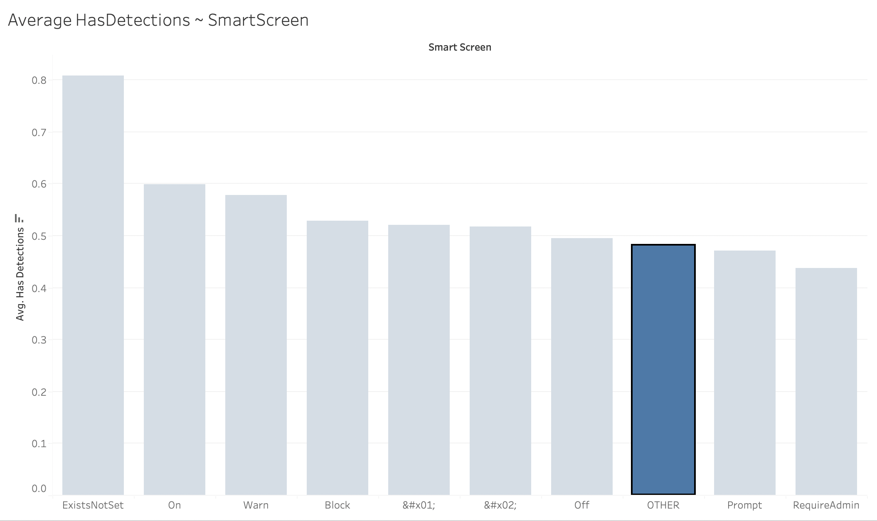
Cleaning Process
1. Exploratory Data Analysis
Researched Microsoft's definition of features
Distinguished categorical from continuous variables
2. Drop, Rename, and Merge Features
Dropped redundant and empty columns
4. Scaling and Ordinal Encoding
Scaled continuous variables to mean: 0, stdev: 1
3. Imputation
Stripped "Census_" from all feature names
For cont. variables, decided on mean or zero imputer
For cat. variables, decided on "other"/"none" imputer
Coded all cat. variable labels numerically
Merged redundant labels
Example – SmartScreen
1. Exploratory Data Analysis: Categorical variable that captures user’s SmartScreen settings
2. Drop/Rename/Merge: Merged “Off”, “OFF”, and “off” labels
3. Imputation: Combined all np.na’s into “OTHER” label
4. Scaling/Encoding: Transformed each label into a number (not pictured here in order to visualize original cat. labels)
dasd
dasdf

Slide 18
Model Performance
Model Type
Performance*
Model does not have strong predictive power, but highlights key variables for prediction
Random Forest allows us to let the model create interactions terms and limit variables selection at each node.
Source: ScienceDirect
* AUC on validation: 0.71
AUC on test data: 0.58

Slide 19
Recommendations

Slide 20


Recommendations to leverage the model
Keep customers on latest version
Improve customer education
For Consumers
Increase pop-up update reminders to individuals identified as high-risk
Revive “Clippy” as malware security fighting mascot
Send online trainings/security quizzes to individuals at high risk to improve customer recognition and avoidance of unsecure behavior
For Organizations
Translate predictive score to “security metric” and have sales team share warning with high-risk organizations Cross-sell Microsoft Industry Solutions security consulting services
Develop malware education resources that can be shared by organization’s internal communications teams

Slide 21
Next steps
Objectives
Work Required
Use model insights to drive product roadmap
Orient Microsoft’s development team to prioritize addressing security features associated with high predicted malware risk
Better understand which features are creating risk
Example: Dig into Defender Configuration to further understand sources of security risk
Maintain accuracy of model versus world drift
Ensure model accounts for evolving malware risks and updated defenses
Regularly retrain model with new data
Continue our working relationship by establishing data gathering procedures and model update schedule

